Slide 1


DAYANANDA SAGAR UNIVERSITY
SCHOOL OF ENGINEERING
Department of Computer Science and Engineering
(Artificial Intelligence & Machine Learning)
FINAL INTERNSHIP REVIEW
SHIPPING ROUTE EFFICIENCY ANALYSIS FOR THE LOGISTICS SECTOR
Under the Supervision
Ms. Dhrishti Madaan
Dr. Joshuva Arockia Dhanraj
Presented By:
Rahul V (ENG22AM0189)

Slide 2


Slide 3

TABLE OF CONTENTS
01
04
02
05
03
06
Internship Overview
Methodology
Introduction
Experimentation
Problem Definition
Results
Dept of CSE (AI & ML), SOE-Dayananda Sagar University

Slide 4
INTERNSHIP OVERVIEW
COMPANY NAME | Unified Mentor Pvt. Ltd.
DURATION | 3 Months (25th March 2026 to 25th June 2026)
PROJECT NAME | SHIPPING ROUTE EFFICIENCY ANALYSIS FOR THE LOGISTICS SECTOR
TECH STACK | Python 3.14, Pandas, NumPy, Streamlit, Plotly, Pandera, Pytest, PyYAML
EXTERNAL GUIDE NAME | Ms. Dhrishti Madaan
Dept of CSE (AI & ML), SOE-Dayananda Sagar University

Slide 5
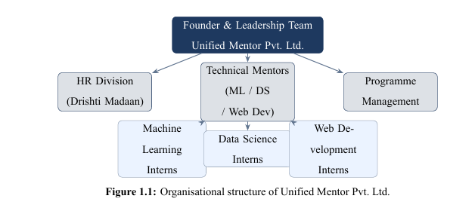

Slide 6
INTRODUCTION
Data Transformation: Converted raw multi-factory shipping records into actionable intelligence using a production-grade Python architecture.
Signal Extraction: Developed a custom cohort-based normalization algorithm to isolate genuine 0–11-day lead time signals from noisy, high-baseline datasets.
Efficiency Benchmarking: Created a 0–100 Route Efficiency Score to evaluate performance across specific factory-region and shipping mode combinations.
Quality & Validation: Utilized pandera for rigorous schema validation and Pandas/NumPy for robust statistical processing of complex distribution networks.
Interactive Visualization: Deployed a Streamlit dashboard featuring 10 distinct Plotly chart types to provide stakeholders with real-time operational insights.
Dept of CSE (AI & ML), SOE-Dayananda Sagar University

Slide 7
PROBLEM DEFINITION
The distribution sector client lacked quantitative visibility into their complex multi-factory network, forcing critical decisions on shipping modes and factory allocations to be made without data-driven insights. Because raw transactional data remained untapped, the business could not track SLA compliance or identify geographic performance trends, leaving regional lead-time patterns and route inefficiencies entirely invisible to stakeholders.
Problem
Solution
Engineered an end-to-end analytics platform that computes a 0–100 Efficiency Score for every route via min-max normalized lead times while tracking seven critical KPIs, including profitability and delay frequency. The solution features an interactive US choropleth map with factory overlays and a self-service filtering suite, allowing users to transition from high-level geographic trends to granular, order-level Gantt timelines for comprehensive route drill-downs.
Dept of CSE (AI & ML), SOE-Dayananda Sagar University

Slide 8
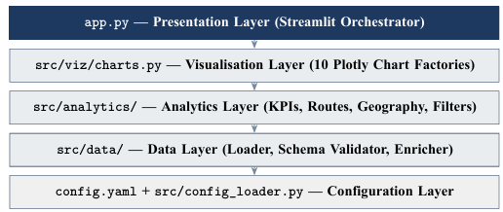
Model Architecture
Dept of CSE (AI & ML), SOE-Dayananda Sagar University

Slide 9
EXPERIMENTATION
Dataset: ~10,194 historical shipping records, 18 attributes per record
Independent variables: Ship Mode (4), Region (4), Factory (5)
Dependent variable: Relative Lead Time (0–11 days) → Efficiency Score (0–100)
Approach: Grouped aggregation by (Factory, Region, Ship Mode) → min-max normalisation
Validation: 28 automated unit tests (pytest) — 100% pass rate
Dept of CSE (AI & ML), SOE-Dayananda Sagar University

Slide 10
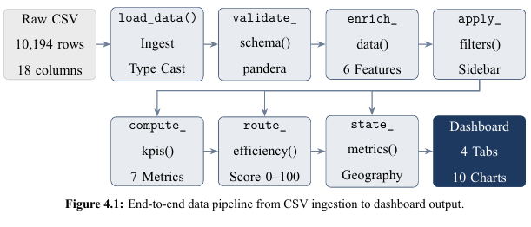

Slide 11
RESULTS
Metric | Value
Total Routes Scored | 36 distinct (Factory × Region × Ship Mode) combinations
Highest Efficiency | Pacific region + Same Day (Avg. Score: 96.3)
Lowest Efficiency | Gulf region + Standard Class (Avg. Score: 71.2)
Lead Time Signal Range | 0–11 days (relative), after cohort normalization
Unit Tests | 28 tests, all passing
Dashboard Charts | 10 interactive Plotly charts across 4 tabs
Source Modules | 12 Python modules, ~1,400 lines total
Dept of CSE (AI & ML), SOE-Dayananda Sagar University

Slide 12
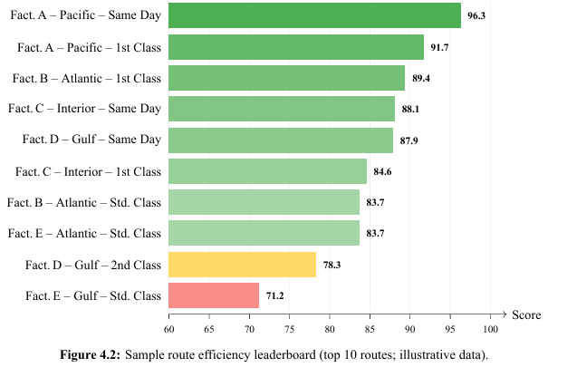

Slide 13
REFERENCE
[1] Streamlit Inc. (2024). Streamlit Documentation. Retrieved from https://docs. streamlit.io
[2] Plotly Technologies Inc. (2024). Plotly Python Open Source Graphing Library. Retrieved from https://plotly.com/python
[3] The Pandas Development Team. (2024). pandas: Powerful Python Data Analysis Toolkit (Version 3.0.2). Retrieved from https://pandas.pydata.org
[4] Niels Bantilan et al. (2024). pandera: Statistical Data Testing and Validation for Pandas (Version 0.30.1). Retrieved from https://pandera.readthedocs.io
[5] Harris, C. R., Millman, K. J., van der Walt, S. J., et al. (2020). Array programming with NumPy. Nature, 585, 357–362.
[6] McKinney, W. (2022). Python for Data Analysis: Data Wrangling with pandas, NumPy, and Jupyter (3rd ed.). O’Reilly Media.
[7] Rushton, A., Croucher, P., &Baker, P.(2014).TheHandbookofLogisticsandDistribution Management (5th ed.). Kogan Page.
[8] Few,S.(2009).NowYouSeeIt: SimpleVisualizationTechniquesforQuantitativeAnalysis. Analytics Press

